Slide 1


Open and Responsible Research 2
Open Science
Louise Bezuidenhout
Emanuele Ratti
September 2021 CODATA-RDA Data Science School

Slide 2

Increasingly Digital
Amount and types of data being produced
Practices of science
What constitutes “good research”
How responsible conduct of research is understood
Notes:
But things are changing fast
Digital revolution is changing the way science is conducted

Slide 3
Translating RCR into a Digital Age
Understandings of RCR in a digital age continue to evolve
Extension of existing discussion, but also new areas for concern
Opportunity to share vs loss of control
Increase benefits of research for public vs possible harms
(Un)Intended marginalizations
Data recombination, re-use

Slide 4
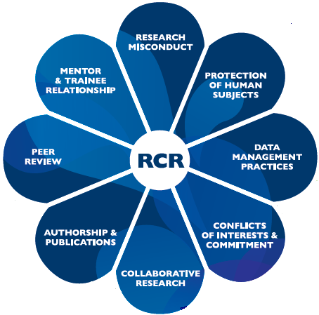
New Questions for RCR
How can the evolving power of digital technologies be harnessed to uphold the principles of responsible research?
How can practices and structures of scientific research be adapted to ensure that research benefits the most number of people?
How can the culture of science be adapted to support this evolution?
What is the role of the individual scientist/institution/nation/infrastructure in this revolution?
How do we ensure that we create presents and futures that uphold ethical principles and allow research with integrity?

Slide 5
What Is Needed Is More Openness
There is an historical precedence for this argument:
Openness is a core value of science/research
Merton 1942
Communalism
Universalism
Disinterestedness
Organized skepticism
Long tradition of sharing resources and scrutinizing research
Transparency of data and sharing of resources key to addressing issues of reproducibility, networking and public trust
Notes:
Not a new concept

Slide 6
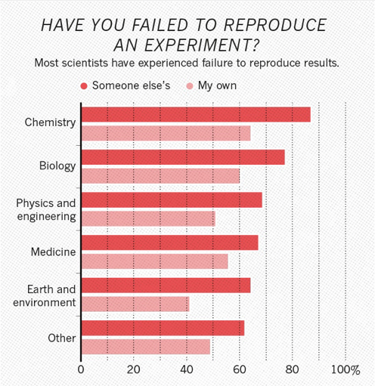
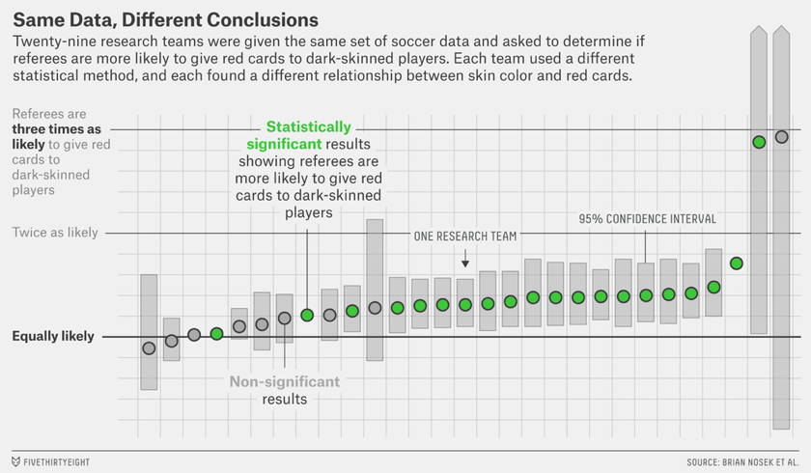
A Reproducibility Crisis?
Nature survey of 1,576 researchers (Baker et al 2016)
https://psyarxiv.com/qkwst/

Slide 7
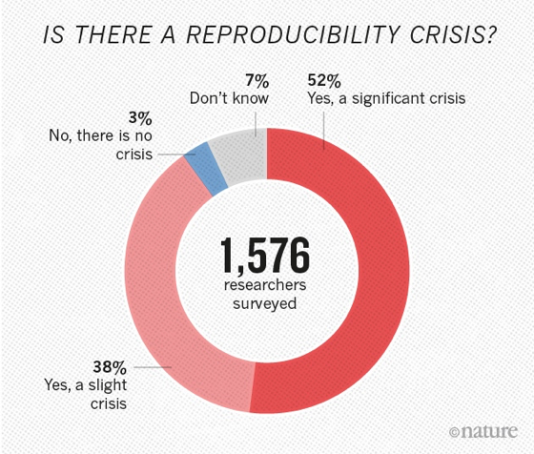
A General Consensus?
Variability in analysis and methodology
Incentives aligned towards publication not reproducibility
Lack of transparency and access to data
Nature survey of 1,576 researchers
(Baker et al 2016)
Notes:
Increasing transparency and quality
in the research validation
process, by allowing greater replication and validation of
scientific results.
•

Slide 8
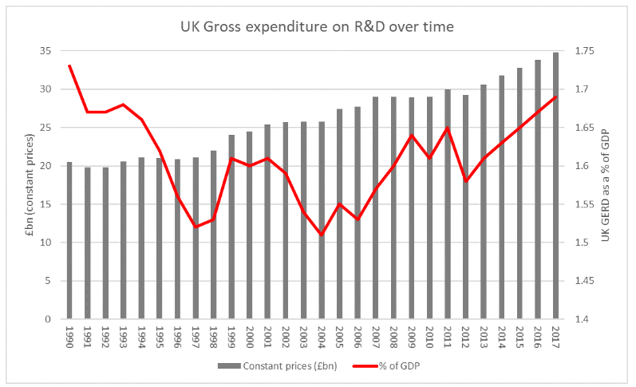
Returns on Public Investment
http://www.sciencecampaign.org.uk/news-media/case-comment/uk-r-d-investment-rises-in-2017.html
Notes:
Improving efficiency in science
by reducing duplication and the
costs of creating, transferring and re-using data; enabling more
research on the same data.

Slide 9
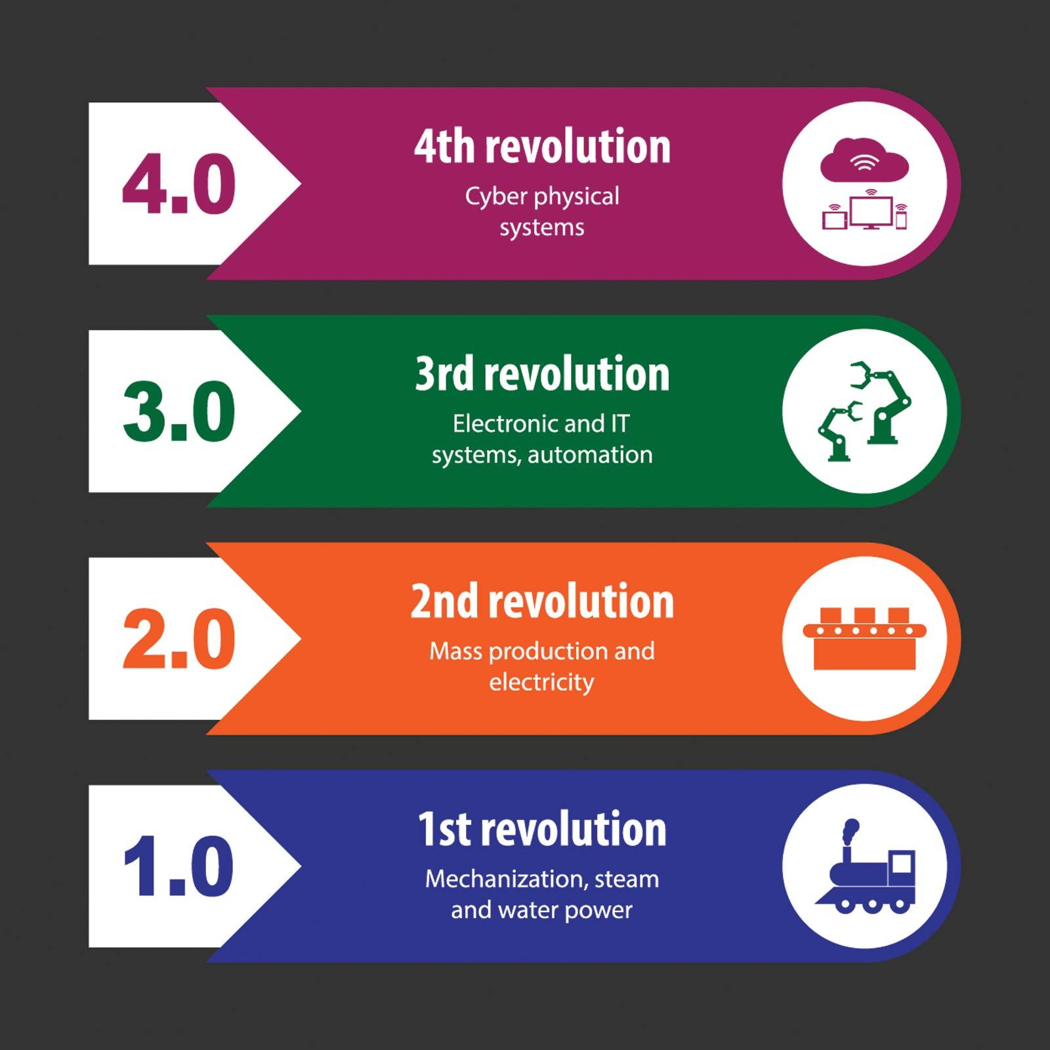
New Forms/Places of Knowledge Production
Big Data
AI
Social data
Citizen science
Blurred boundaries between academia, commerce and government
https://www.britannica.com/topic/The-Fourth-Industrial-Revolution-2119734

Slide 10

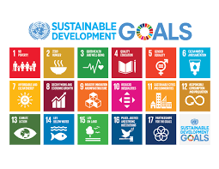

Slide 11
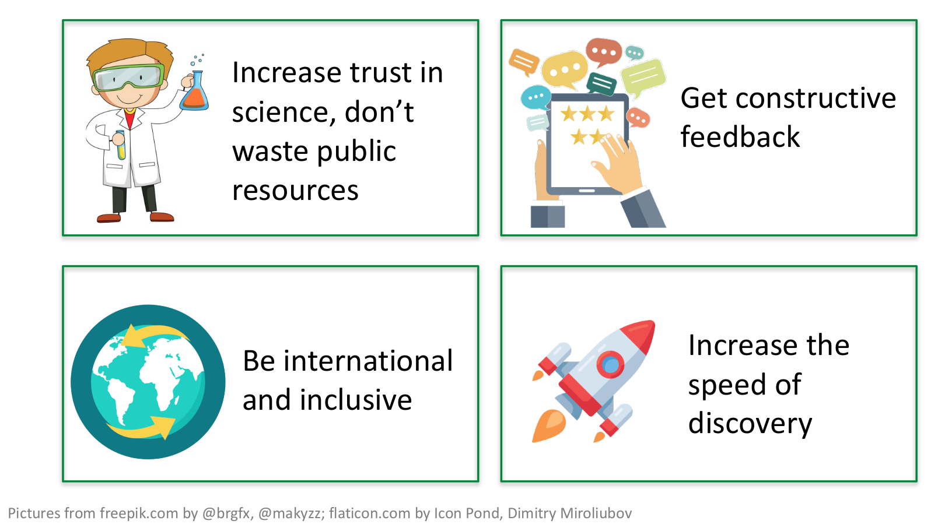
Time For A New Approach?
Slide taken from the LMU OSC toolbox

Slide 12
Open Science
The products of scientific research should be freely available to everyone to use and republish as they wish, without restrictions from copyright, patents or other mechanisms of control
Open Science includes activities that:
facilitate resource sharing
improve awareness of sharing
create linkages between resources
advocate for removal of financial barriers

Slide 13
Open Science
The movement to make scientific research, data and dissemination accessible to all levels of an inquiring society
https://www.fosteropenscience.eu/taxonomy/term/7]
Scope:
Transparency in experimental methodology, observation, and collection of data
Public availability and reusability of scientific data
Public accessibility and transparency of scientific communication
Using web-based tools to facilitate scientific collaboration
http://www.openscience.org/blog/?p=269]

Slide 14
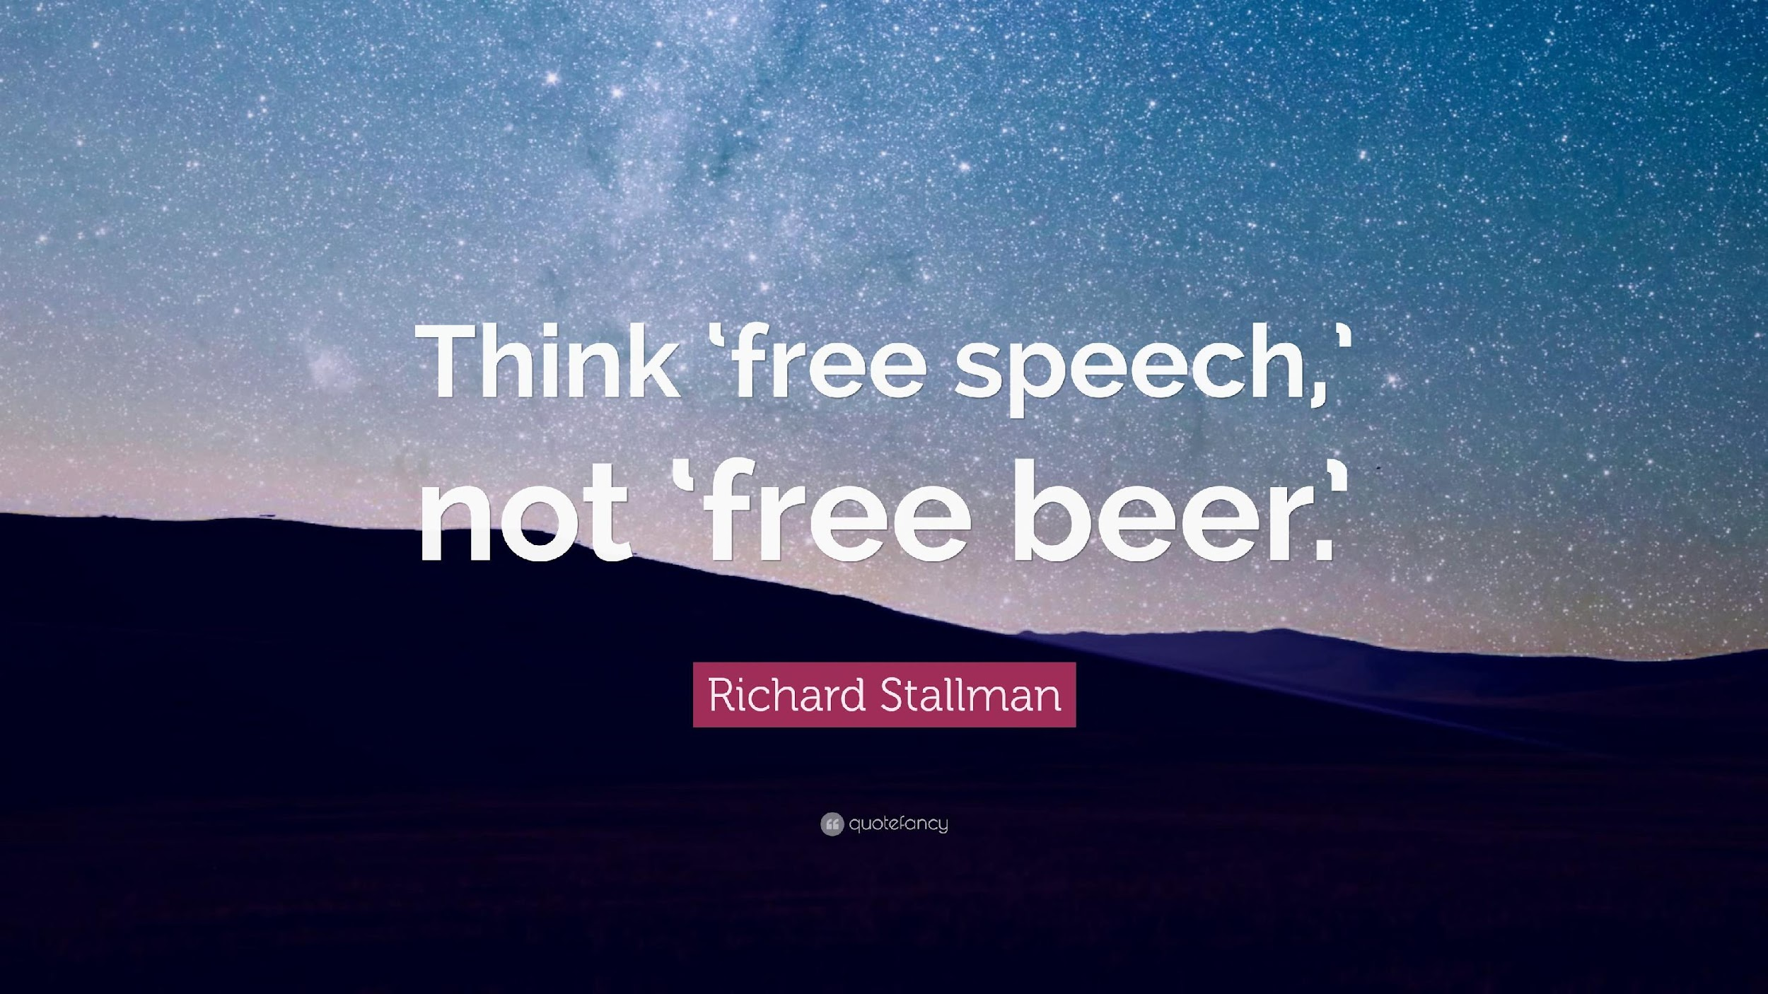
Free Speech ... Not Free Beer
Gratis versus Libre
"Free" means there is no cost, where libre means "at liberty", referring to the freedom to modify source code. Libre doesn't mean gratis. Libre can mean available. Libre can mean without restriction

Slide 15

As Open As Possible, As Closed As Necessary
https://www.timeshighereducation.com/blog/data-should-be-open-possible-and-closed-necessary

Slide 16
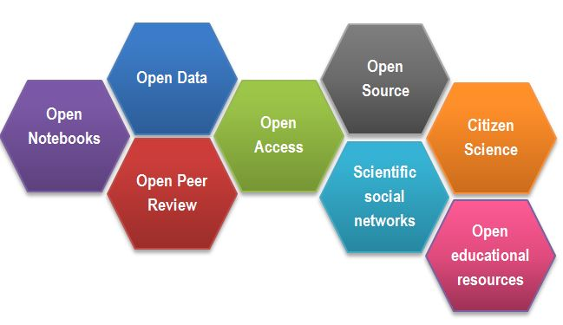
Open Science: an Umbrella of Many Activities
https://www.fosteropenscience.eu/content/what-open-science-introduction
Notes:
Open Notebooks -
an emerging practice,
documenting and sharing the experimental
process of trial and error;
•
Open Data
-
managing research data in a way that
optimises access, discoverability and sharing for
use and re-use;
•
Open Research Software
- documenting research
code and routines, and making them freely
accessible and available for collaboration;
•
Open Access
- making all published outputs freely
accessible for maximum use and impact.

Slide 17
Open Science Throughout The Research Lifecycle
Open Access
Acquire
Open Data
Present
Clean
Validate
Open Materials
Explore
Model
Preprocess
Open Source
Heidi Seibold
tinyurl.com/opendatascience

Slide 18
A Way of Thinking And Doing
An ideology as well as a set of practical actions
Changing the way we think about responsible research
Requires buy-in and commitment

Slide 19
Open Science as … a Set of Practices
The practice of science in such a way that others can collaborate and contribute, where research data, lab notes and other research processes are freely available, under terms that enable reuse, redistribution and reproduction of the research and its underlying data and methods
Practice-based ethics

Slide 20
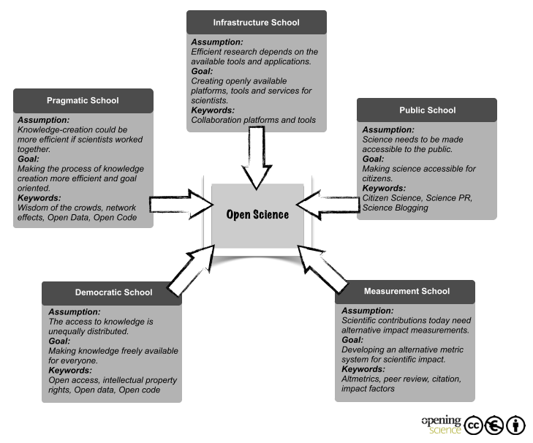
Different Motivations, Same Response
(Fecher and Friesike, 2014)
https://www.fosteropenscience.eu/content/what-open-science-introduction

Slide 21
Open Science as … a Cultural Change
The products of scientific research should be freely available to everyone to use and republish as they wish, without restrictions from copyright, patents or other mechanisms of control
Justice, responsibility, egalitarianism

Slide 22
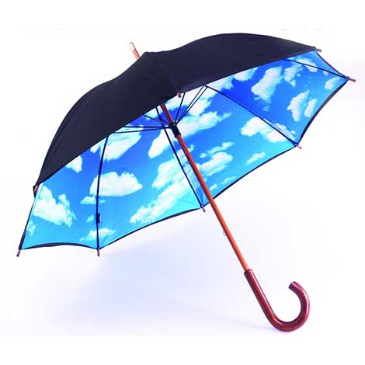
Open Science is Many Things
Open Science includes activities that:
facilitate resource sharing
improve awareness of sharing
create linkages between resources
advocate for removal of financial barriers
advocate for just distribution of resources

Slide 23
Open Science: an Extension of RCR Values
Openness can be thought of as an extension of RCR
Allows researchers to uphold integrity and core ethical values underpinning RCR
Allows researchers to engage in practical activities relating to RCR

Slide 24
Openness as an Extension of RCR
A just distribution of resources (public funds and research products)
A way of maximizing the benefits of research
A safeguard against possible harms arising from research
As a means of improving accountability and transparency
An enactment of collegiality

Slide 25
Openness in RCR
Open Data and Open Methodologies:
Improve transparency and reproducibility of research
Open Lab Books: Transparency in research practices
Sharing and openness: enhance transmission of values
Open Peer Review: Transparency in peer review leads to better dialogue and collegial behaviour
Open Access: Improves availability of research outputs
Open publishing: leads to improved citations, credit and collaboration
Open Science Tools:
Improve collaboration

Slide 26
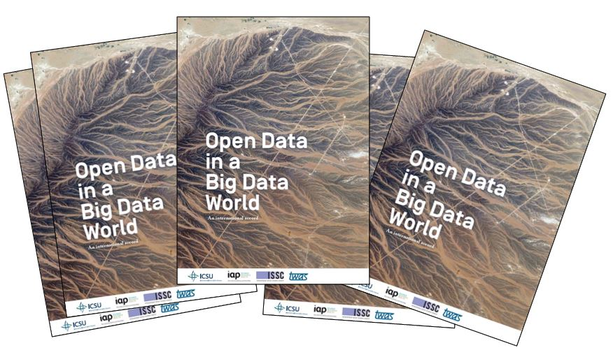
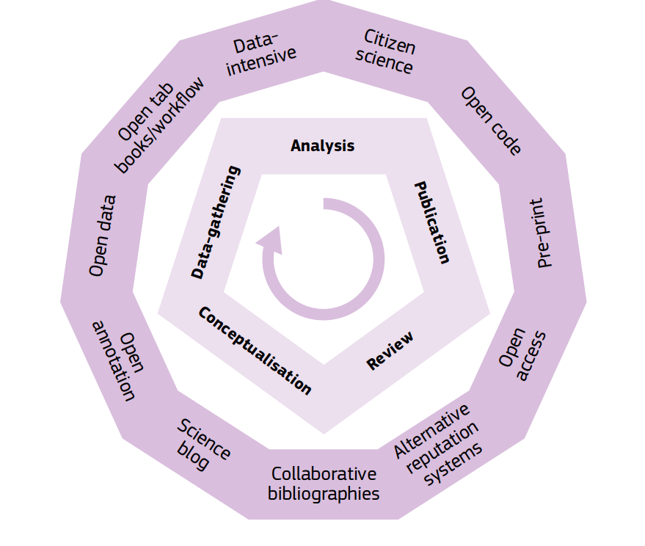
Extending the Reach of RCR
Creating new visions for the future
Policy: guiding research priorities and practices
Open Education, Open Hardware: getting marginalized communities into research

Slide 27
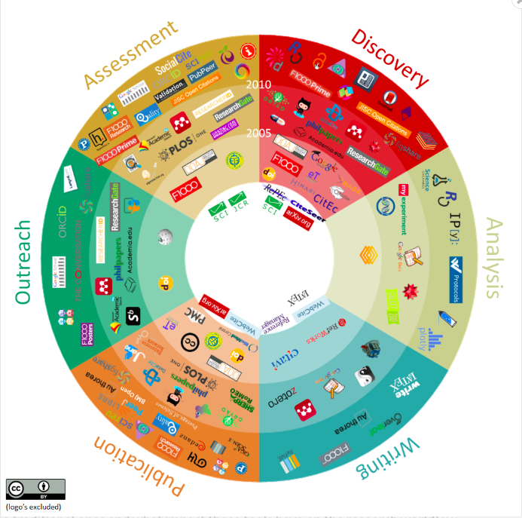
Extending the Reach of RCR
Changing the way research is done
Changing the tools in research
Linking up areas, disciplines and communities
www.openuphub.eu/component/k2/item/610-101-innovations-in-scholarly-communications

Slide 28
Big Picture/Little Picture
Open Science is a cultural movement as well as a set of practices
Individual researchers can show support for Open Science through the way they do their research
Can make changes to daily research practices to be more open in all aspects of research
There is no “hard and fast” rule – openness must work for you within your specific work context and with your daily challenges

Slide 29
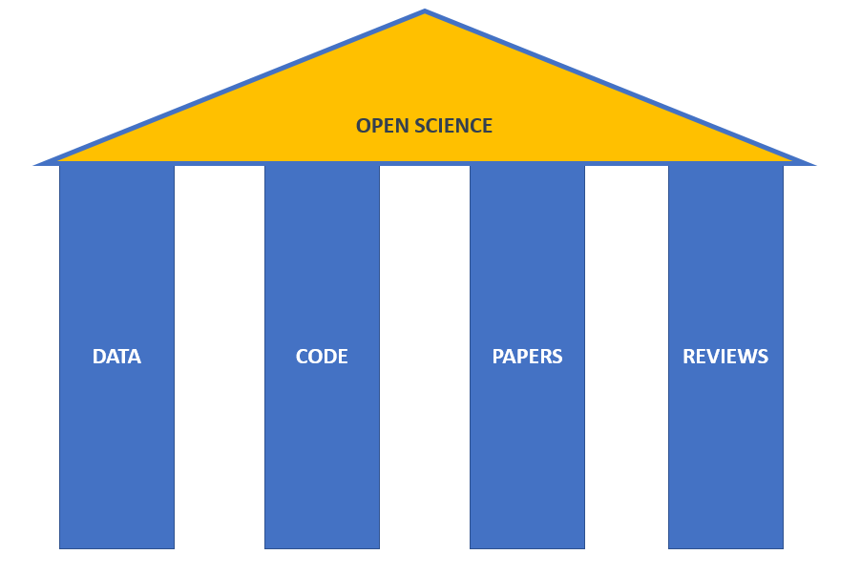
“My” Open Science

Slide 30
Different Actions at Different Stages
Create
Preserve
Document
Share
Use
Store

Slide 31
Individual Openness: More Than Open Access
Share your data - the research data that underpins publications should also be accessible to support validation and facilitate reuse. In cases where data sensitivities won't allow open access, be sure to provide details on how someone could request authorised access.
Share your code - many researchers now develop bespoke bits of code to help them analyse and/or visualise the data they have collected. Having access to this code is essential for supporting the validation of your findings and to help others to build upon your work.
Share your workflows - without knowing what steps were taken to capture, process and analyse the data - and in what order - it can be virtually impossible to validate published findings. This has led to what some are calling the Reproducibility Crisis. Nature's special issue on Challenges in Irreproducible Research gives you a better sense of the scale of this problem.
www.fosteropenscience.eu

Slide 32
Pragmatic Openness
Openness in research is new ... And can be scary
It’s ok to have concerns
It’s ok to realise that not all the open practices will work for you
There can be legal, regulatory, ethical reasons not to share
However, you benefit from the increasingly open research landscape (papers, data, software)
So, how can one avoid ”freeloading”?

Slide 33
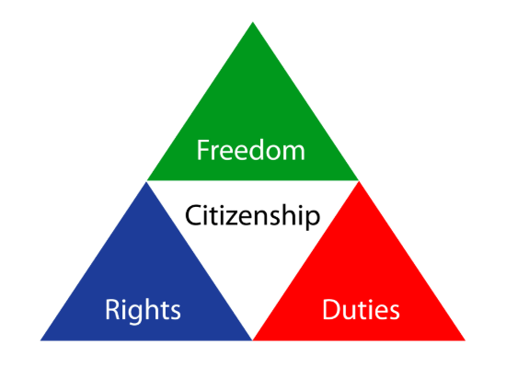
Responsible and Open Research as Citizenship
Citizenship:
ethical obligations arising out of social living
being part of a community requires the acceptance of civic responsibilities and contribution to the overall public good
As a citizen you have duties and expected ways of acting
Follow rules
Participate in community activities
Protect the community and its resources from misuse

Slide 34
Responsible and Open (Data) Science Citizenship
Research is a community endeavour
involves social actions such as resource sharing and communal practice
responsible researchers are “citizens” of the research community
Citizenship is a give and take
Benefits to facilitate freedom of research
Structures to safeguard rights as researcher
Responsibilities to assume to protect culture
Support and grow culture instead of just living in it
Notes:
Like being a citizen of a country – you are still a citizen when you are at work, or brushing your teeth, or playing with your children
Your cultural values influence everything that you do and the way that you do it
Similarly for RCR – think of it as a citizenship to the global science community
The values of RCR provide a lens through which you conduct all your different activities – all the different hats that you wear
Give and take

Slide 35
Responsible and Open (Data) Science Citizenship
RCR and Open Science form the blueprint for a form of ”science citizenship”
Research relies on the use of “community resources”
data, papers and so forth
As a “citizen” of the research community you therefore have responsibilities for these resources
follow community determined rules (such as citation, licensing and so forth)
Contribute to communal resources (data sharing)
Maximise good for the community by participating in civic service (reviewing, curating etc)

