Slide 1



Computational Infrastructures an overview
Alessandro Costantini
INFN, Italy

Slide 2


Training Goals
Learn the concept of
  Local vs Distributed
  Examples of
    High Performance Computing (HPC)
    High Throughput Computing (HTC)
    Cloud
Computational Infrastructures, Costantini et al. 2020

Slide 3

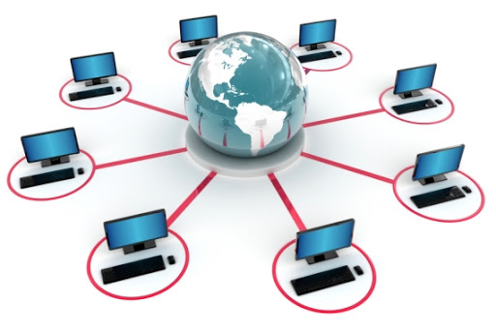
Local vs Distributed Computing
The science computing is becoming complex
- Monte Carlo, image analysis, genetic algorithm, simulation...
It will take a year (CPU time) to get the results on your laptop, but your paper is due in a week.
What do you do?
You have the following options:
Wait until the calculation is done
Use a distributed computing environment to speedup
Computational Infrastructures, Costantini et al. 2020

Slide 4
Distributed computing environment
Distributed computing is a field of computer science that studies distributed systems. A distributed system is a system whose components are located on different networked computers, which communicate and coordinate their actions by passing messages to one another.
High Performance Computing (HPC)
High Throughput Computing (HTC)
Cloud
Computational Infrastructures, Costantini et al. 2020

Slide 5
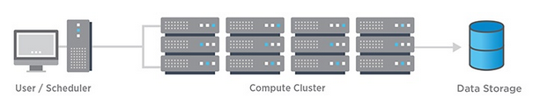
High Performance Computing
High Performance Computing (HPC) is the ability to process data and perform complex calculations at high speeds
Fast access to network/disk/memory
  Limited resources
Needs
  A highly parallel program or
  Port your code to a special environment
  Request and wait for an allocation
Computational Infrastructures, Costantini et al. 2020

Slide 6
High Throughput Computing
Instead of the fastest computer, lots of individual “commodity” computers
  May not be fastest network/disk/memory, but you can access a lot of them
  Job can be broken down into separate, independent pieces
    If I give you more computers, you run more jobs
    You care more about total quantity of results than instantaneous speed of computation
Computational Infrastructures, Costantini et al. 2020

Slide 7
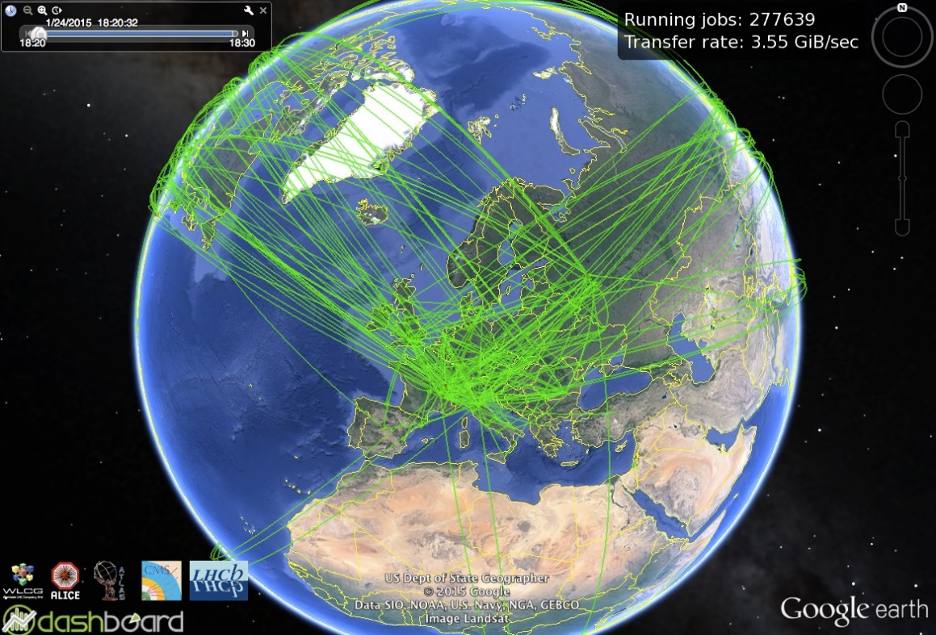
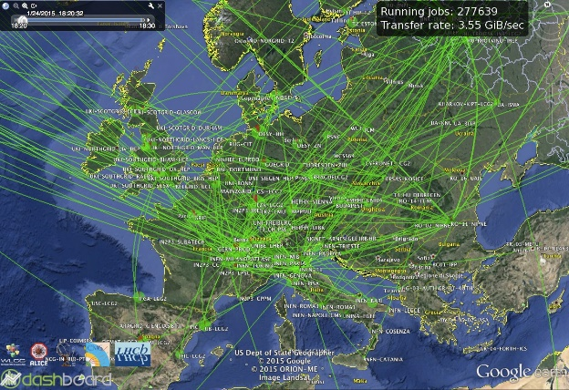
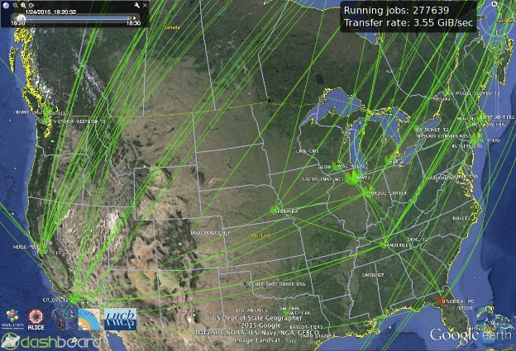
Grid Computing
Provisioning and use of massively distributed and federated resources routinely happens since several years.
An example of great success in the scientific world is given by Grid Computing.
On the right:
  Real-time situation of computation and data transfer for the physics experiments running at the CERN Large Hadron Collider (LHC).
Computational Infrastructures, Costantini et al. 2020

Slide 8
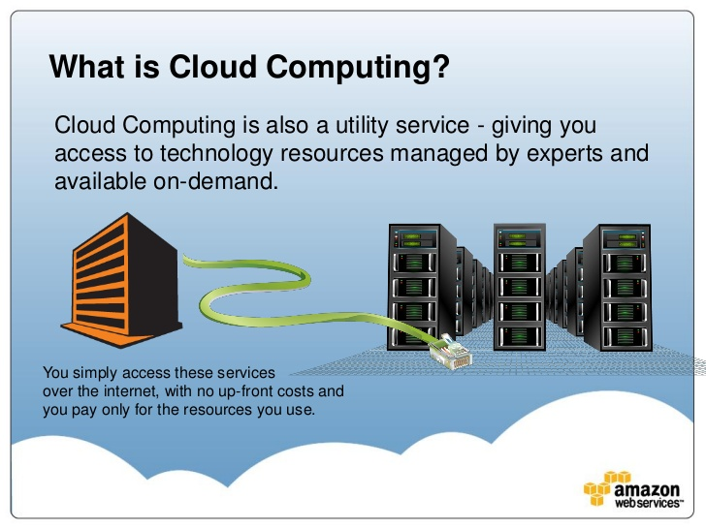
Cloud computing
In a nutshell, Cloud Computing
deals with:
Supplying
information and communication technologies
as a service
1
2
3
Source: bit.ly/2Z4kHNG
US National Institute of
Standards and Technology
(NIST) bit.ly/2YOop2X
Computational Infrastructures, Costantini et al. 2020

Slide 9
Characteristics
Self-service, on-demand
  A consumer can unilaterally provision computing capabilities as needed automatically without requiring human interaction with each service provider.
Network-based access
  Capabilities are available over the network and accessed through standard mechanisms that promote use by heterogeneous thin or thick client platforms
Resource pooling
  The customer has no control or knowledge over the details of the provided resources, that are managed by the Cloud provider
Elasticity
  Capabilities can be elastically provisioned and released to scale rapidly commensurate with demand. To the consumer, the capabilities available for provisioning often appear to be unlimited
Pay-per-use
  The customer pay only for what he/she used.
Computational Infrastructures, Costantini et al. 2020

Slide 10
Information and Material
https://opensciencegrid.org/dosar/DataTrieste2019/Materials/
https://github.com/CODATA-RDA-DataScienceSchools/Materials/tree/master/docs/DataSanJose2019/CI
Alessandro Costantini – alessandro.costantini@cnaf.infn.it
Computational Infrastructures, Costantini et al. 2020

Slide 11



Contact
Alessandro Costantini – alessandro.costantini@cnaf.infn.it
Contributors
      Alessandro Costantini - INFN
      Robert Quick - IU
      Cristina Doina Duma - INFN
      Gergely Sypos - EGI
      Giuseppe La Rocca - EGI

