Slide 1



Computational Infrastructures:
Cloud oriented Services
Alessandro Costantini
INFN, Italy
Insert logo INFN

Slide 2


Training Goals
Cloud Services for the public
Google Cloud platform
AWS
  Cloud Services for the scientific communities
  INFN Cloud
  EGI federated cloud
Computational Infrastructures, Costantini et al. 2020

Slide 3
Google Cloud Platform
Google Cloud Platform (GCP), offered by Google, is a suite of cloud computing services
Registration requires a credit card or bank account details.
Google Cloud Platform provides the following environments
  infrastructure as a service
  platform as a service
  serverless computing.
Computational Infrastructures, Costantini et al. 2020

Slide 4
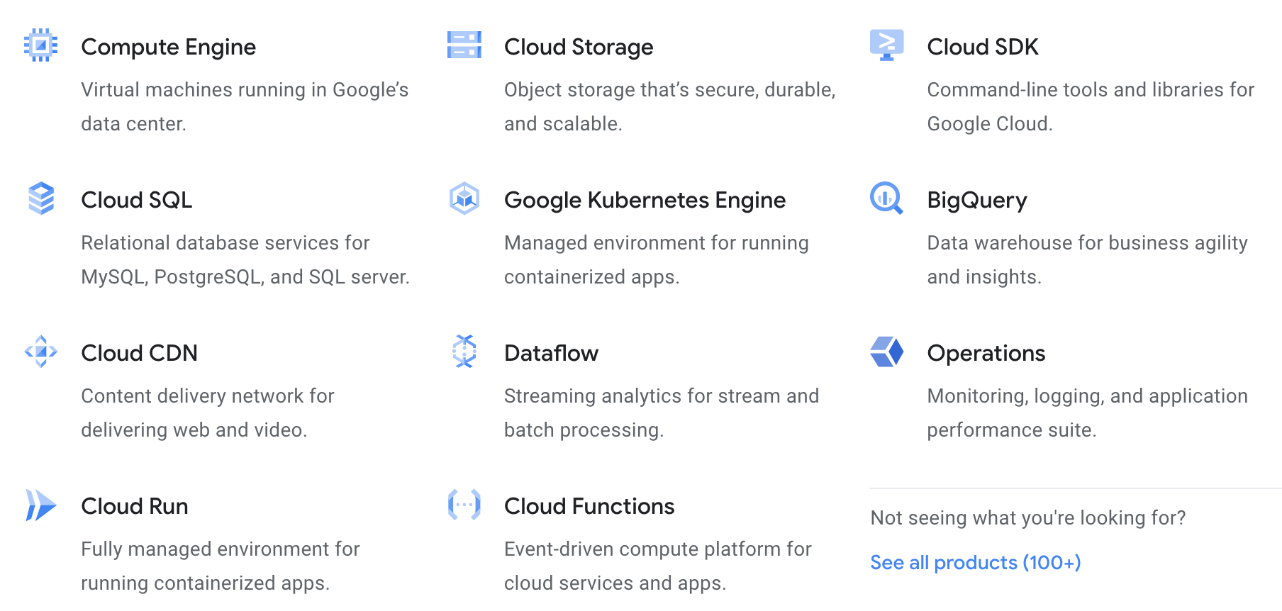
Google Cloud Platform
Alongside a set of management tools, it provides a series of modular cloud services including
  Compute
  Storage & Databases
  Networking
  Big Data
  Cloud AI
  Management Tools
  Identity & Security
  IoT
  API Platform
Source: https://cloud.google.com/products
Computational Infrastructures, Costantini et al. 2020

Slide 5
AWS
Amazon Web Services (AWS) provides on-demand cloud computing platforms and APIs
to individuals, companies, and governments,
provide a set of primitive abstract technical infrastructure and distributed computing building blocks and tools
AWS comprises more than 175 products and services
AWS offers its services as pay-as-you-go basis
Source: https://en.wikipedia.org/wiki/Amazon_Web_Services#cite_note-techradar-11
Computational Infrastructures, Costantini et al. 2020

Slide 6
Services for research commnuities
INFN Cloud
  INFN is offering to its users a comprehensive and integrated set of Cloud services through its dedicated INFN Cloud infrastructure
EGI Federated Cloud
  a multi-national cloud system that integrates community, private and/or public clouds into a scalable computing platform for research in Europe
Computational Infrastructures, Costantini et al. 2020

Slide 7
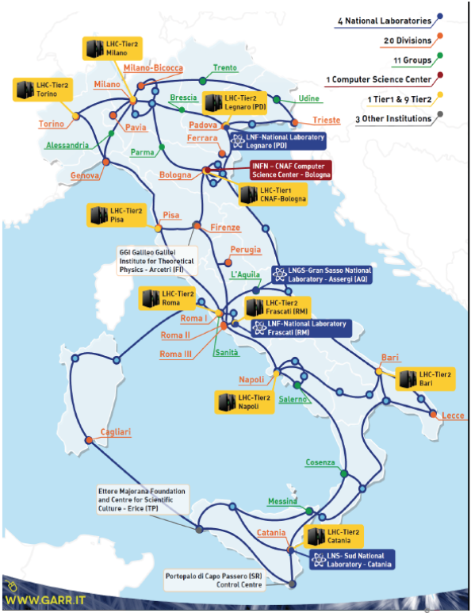

National Institute for Nuclear Physics
Mission
High energy physics experiments in collaboration with worldwide research centers and institutions. For the past 10 years, this mainly meant supporting the experiments @ CERN (LHC), although the scope is now widening very quickly to other communities.
State-of-the-art distributed IT technologies
Cloud computing and related services
Exascale distributed storage services
Cloud-assisted and edge-enabled intelligent systems (ML and DL techniques for industrial digital twins, IoT, medicine and more…)
Currently, INFN operates:
9 medium size centers (Tier-2s in the LHC Computing Grid
1 large Tier-1 center, at CNAF (Bologna)–certified ISO-27001
centers are connected with 10-100 Gbit/s network
  Visit https://www.cnaf.infn.it/
7
Computational Infrastructures, Costantini et al. 2020

Slide 8
Cloud Services: the INFN Cloud example
INFN is offering to its users a comprehensive and integrated set of Cloud services through its dedicated INFN Cloud infrastructure.
The INFN Cloud portfolio
  easy to use web interface but also exploitable via command line interfaces
  defined upon clear user requirements.
  based on composable, scalable, open source solutions and can be easily extended either by the INFN Cloud support team or directly by end users.
Authentication and authorization for accessing all INFN Cloud services
  enforced through the INDIGO-IAM federated solution
  fully compliant with European Open Science Cloud (EOSC) and industry standards.
Access to the INFN Cloud services is currently reserved to INFN personnel
  research agreements with other institutions are foreseen in the future.
Computational Infrastructures, Costantini et al. 2020

Slide 9
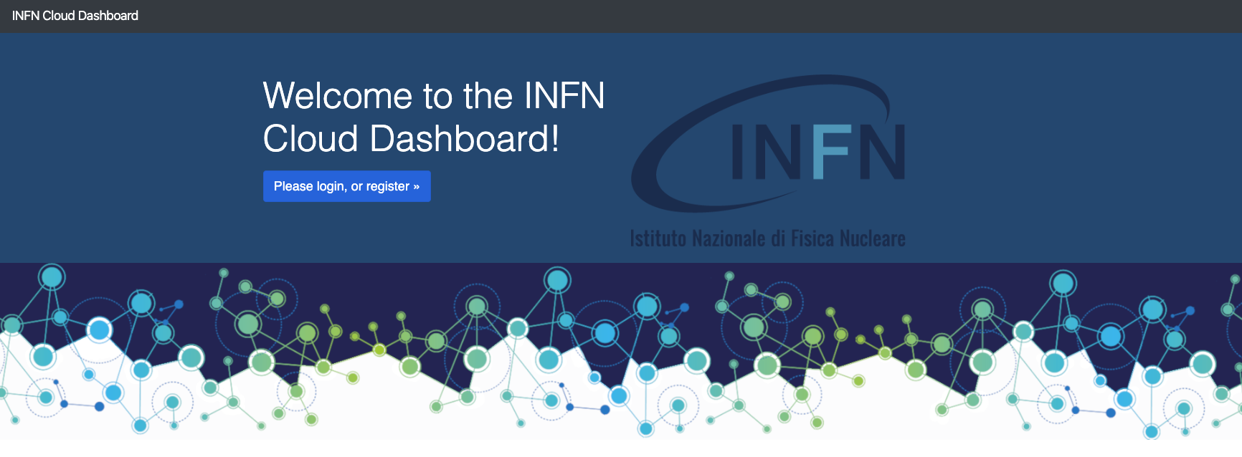
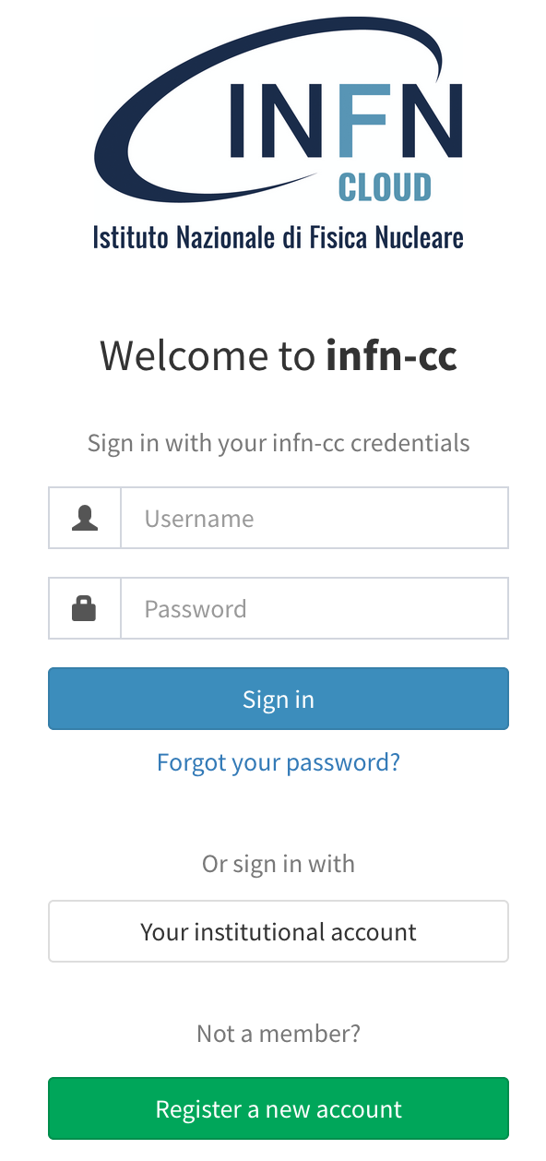
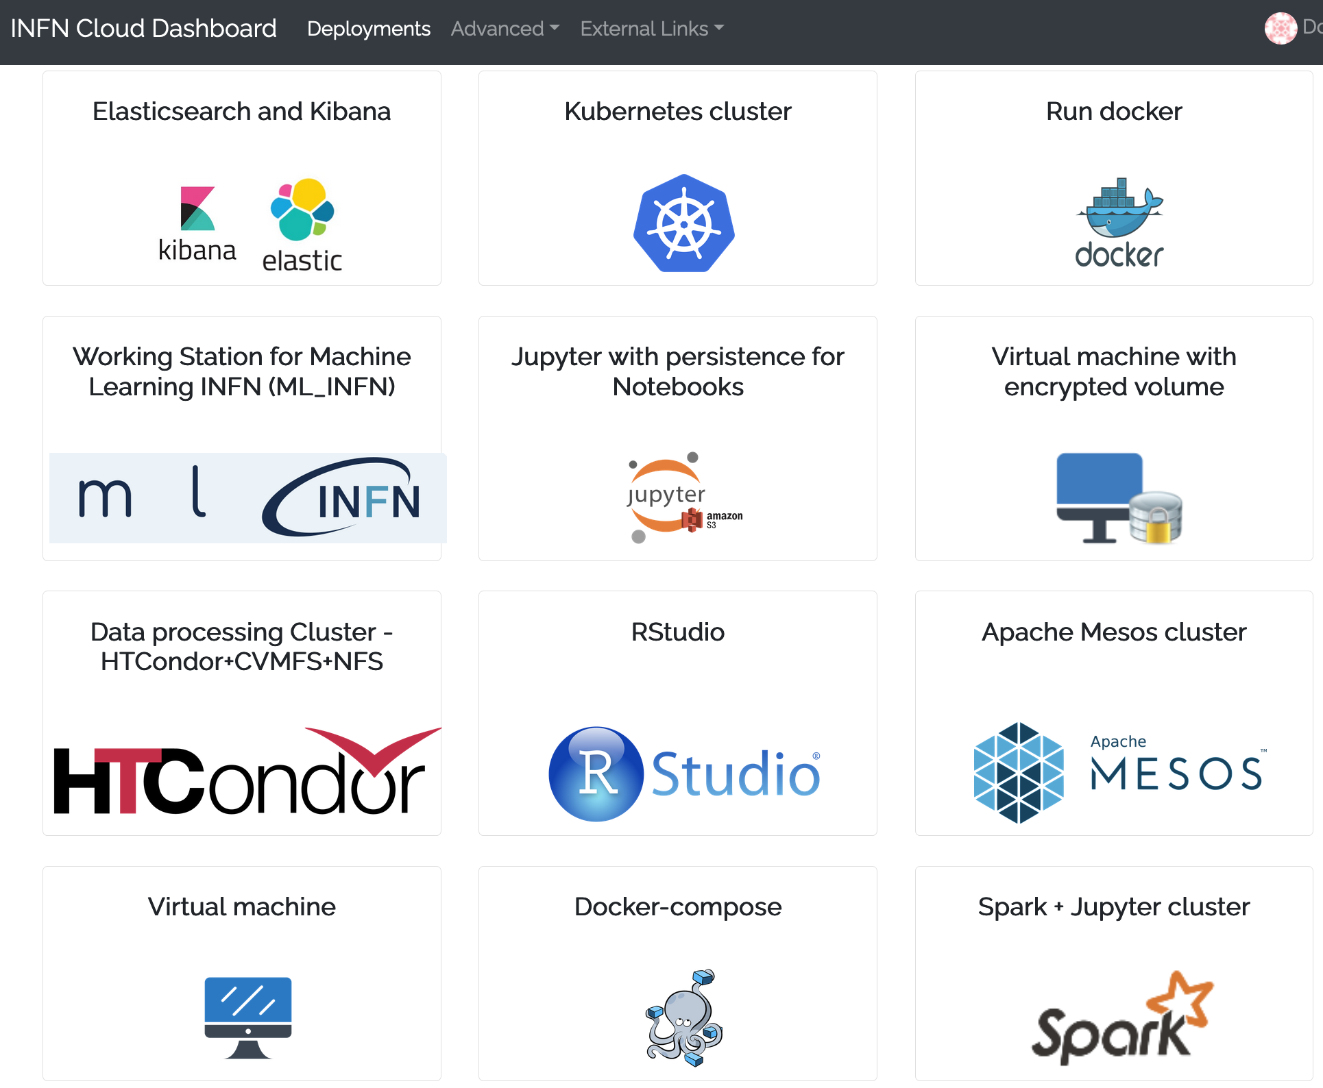
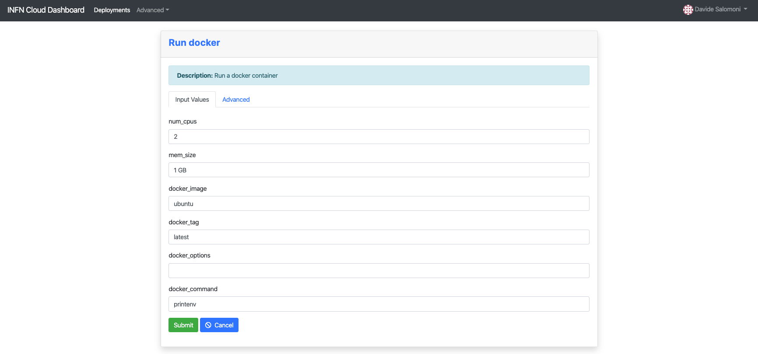
The Dashboard
Access to the Cloud services through a common dashboard, with different views depending on the users / user groups.
Authentication can be enabled for::
Local username/password
Google accounts
EduGAIN (e.g. University, research centers, etc.)
Other OIDC providers
Transparent, multi-site federation for users of Cloud resources belonging to INFN and/or to other Cloud providers (private or public)
Composed, high-level services easily customizable and configurable directly by users
Computational Infrastructures, Costantini et al. 2020

Slide 10

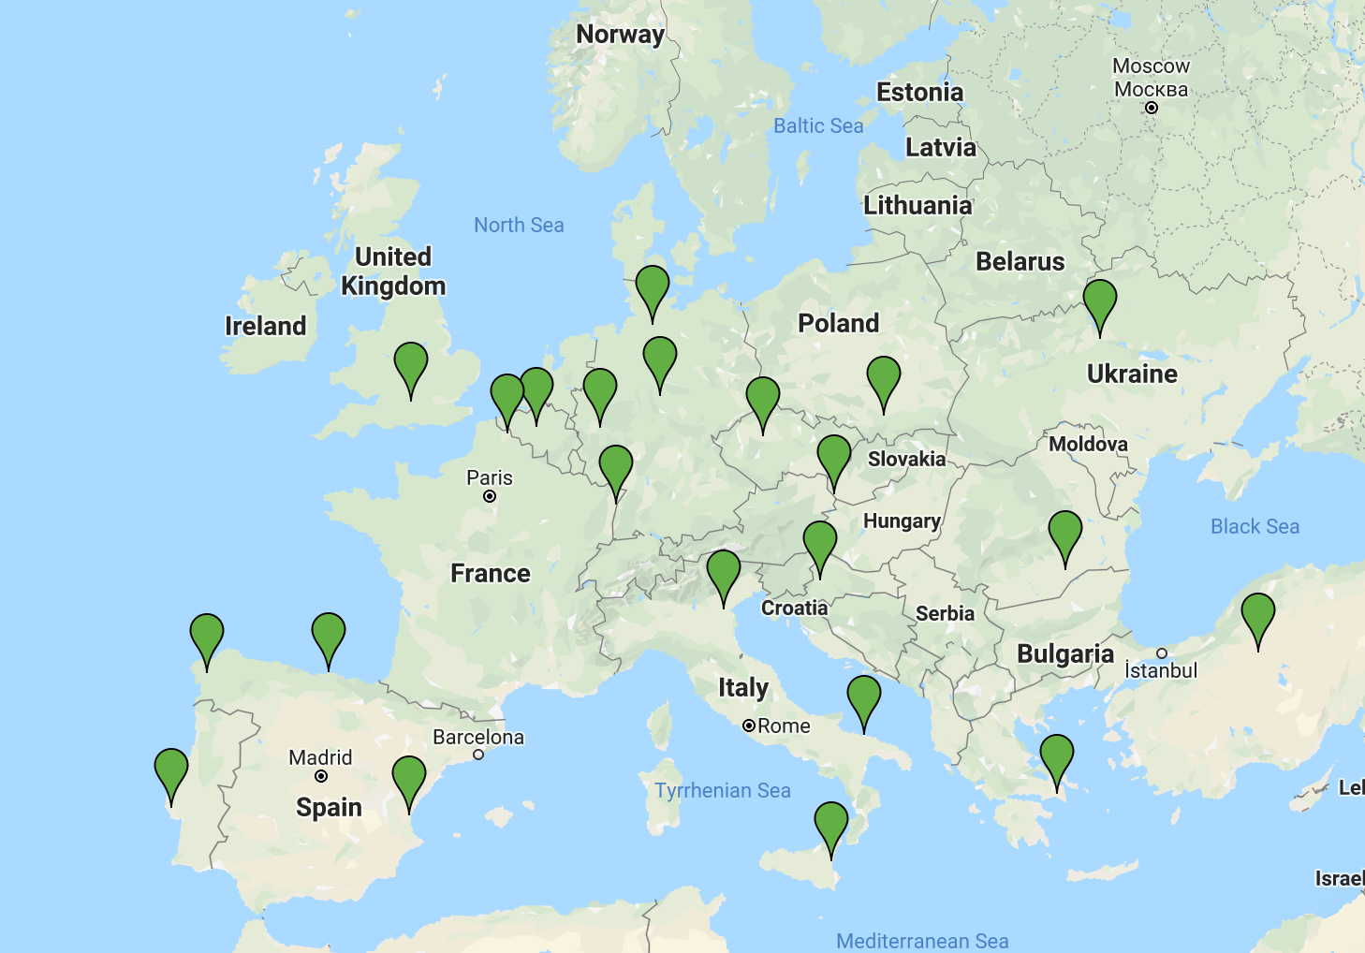
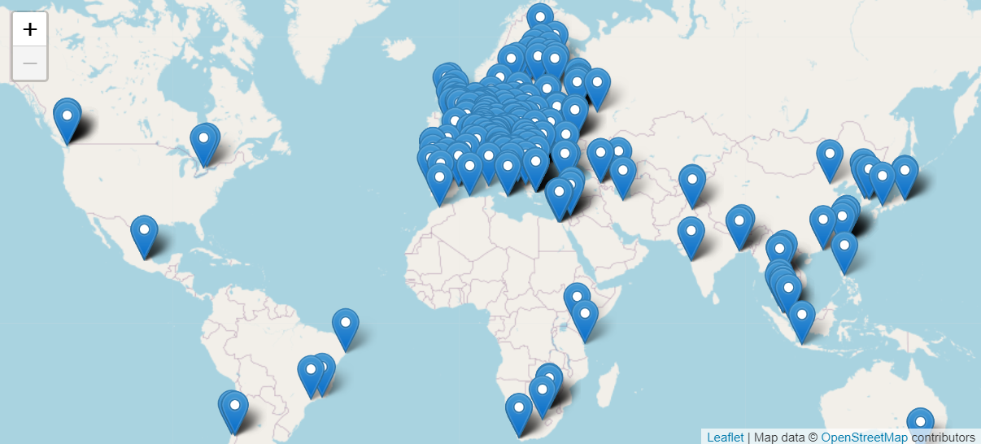
EGI: Advanced computing for research
Mission
To deliver open solutions for advanced computing and data analytics in research and innovation, by coordinating and provisioning an international federated infrastructure from both the public and private sector in Europe. As an open initiative with a global outlook, the EGI Federation also connects service providers beyond Europe following the collaboration needs of the served communities.
EGI fully realises the Open to the World vision
The EGI Federation is an international e-infrastructure that provides advanced computing and data analytics for research and innovation.
Cloud providers
Resource centres
(delivering HTC)
Computational Infrastructures, Costantini et al. 2020

Slide 11
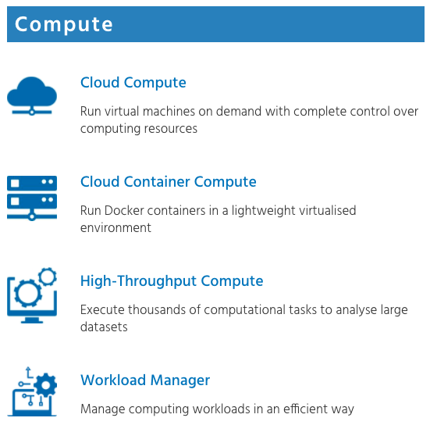
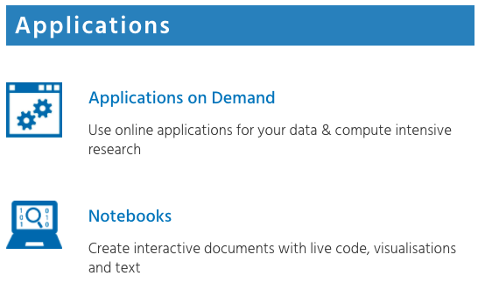
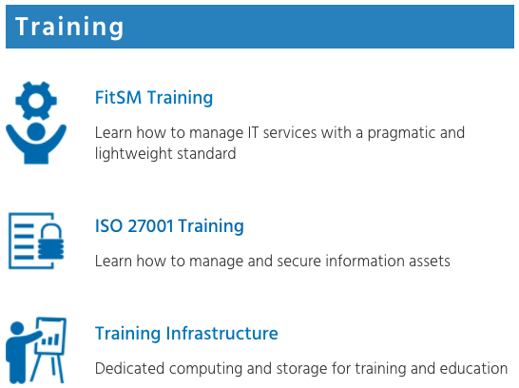

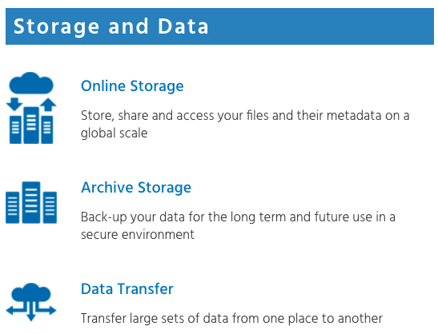


EGI Service Catalogue
https://www.egi.eu/services/
11
Computational Infrastructures, Costantini et al. 2020

Slide 12



Distributed scientific computing enables scientific discoveries…
1700 open access publications / year
LHC Collaboration
LIGO-VIRGO Collaboration
https://www.egi.eu/use-cases/
12
Computational Infrastructures, Costantini et al. 2020

Slide 13
Information and Material
https://en.wikipedia.org/wiki/Amazon_Web_Services#cite_note-techradar-11
https://cloud.google.com/solutions
www.cloud.infn.it
https://www.egi.eu/services/
Alessandro Costantini – alessandro.costantini@cnaf.infn.it
Computational Infrastructures, Costantini et al. 2020

Slide 14



Contact
Alessandro Costantini – alessandro.costantini@cnaf.infn.it
Contributors
      Alessandro Costantini - INFN
      Robert Quick - IU
      Cristina Doina Duma - INFN
      Gergely Sypos - EGI
      Giuseppe La Rocca - EGI
Add logos

